Slide 1
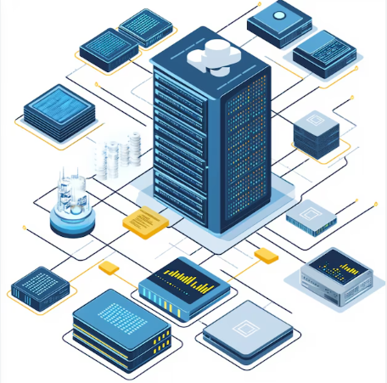
Architectural Design Presentation for Real-time Fraud Detection in a Global Bank
DSC 650 T301 T302 2251 Fall 2024
Week 10 Exercise
Author: Zemelak Goraga
Date: 11/2/2024
Instructor: Prof. Nasheb Ismaily

Slide 2
Problem Statement
Pressing Problem in the Financial Sector:
Global bank is facing increasing fraudulent activities, including unauthorized credit card transactions and suspicious account activities suggestive of money laundering.
Current Challenges Faced:
Delays in detecting and responding to fraudulent activities.
Difficulty in analyzing large volumes of transaction data in real-time.
Need for compliance with global regulations against money laundering.
Ineffective user behavior analysis leading to missed fraud patterns.
Lack of automated systems to block high-risk transactions immediately.

Slide 3
Proposed Architecture - High Level
Role of Each Tool in the Solution:
NiFi: Facilitates data ingestion from multiple sources, including transaction systems and user behavior data.
Kafka: Acts as the backbone for real-time data streaming, transferring transaction data swiftly between components.
Spark: Conducts real-time analysis and machine learning to detect fraudulent patterns and anomalies.
HDFS: Serves as the main storage repository for large-scale data, including raw transactions and historical data.
YARN: Manages cluster resources, ensuring efficient execution of analytics tasks.
Hive: Provides a SQL-like interface for querying data stored in HDFS, supporting data analysis and compliance reporting.
HBase: Manages fast read and write access to real-time data, supporting quick retrieval of user behavior patterns.
Solr: Enhances search and indexing capabilities, enabling fast data retrieval for security monitoring.

Slide 4
Data Flow and Real-time Analysis
Illustrate Data Flow Between Tools:
Data from transactions is ingested through NiFi, sent to Kafka, and then processed by Spark for immediate analysis.
Results are sent to HBase for quick storage, while detailed analysis results are archived in HDFS and made queryable via Hive.
Real-time Fraud Detection:
Spark Streaming: Continuously analyzes incoming data, identifying anomalies and triggering fraud alerts within seconds.
Kafka: Acts as the messaging layer that handles the real-time transfer of transaction data to Spark.
NiFi: Handles the initial data capture, transformation, and routing to ensure clean data reaches Kafka.

Slide 5
Data Storage, Retrieval, and Advanced Analysis
Role of HDFS, Hive, HBase, and Solr:
HDFS: Stores large volumes of historical transaction data that can be used for training fraud detection models and regulatory audits.
Hive: Allows analysts and compliance teams to run SQL queries on stored data, aiding in detailed investigations.
HBase: Provides real-time access to user data, enabling quick validation of current transaction patterns against historical norms.
Solr: Powers advanced search capabilities, enabling fast lookups for suspicious activity and aiding in instant alert generation.
Importance of Solr in Real-time Monitoring:
Facilitates quick searches and filtering of recent transactions, enhancing the ability to respond promptly to fraud alerts.

Slide 6
Benefits and Conclusion
Advantages of the Proposed Solution:
Enhanced Fraud Detection: Immediate detection and blocking of high-risk transactions, reducing financial losses.
Improved Customer Trust: Real-time alerts and security notifications reassure customers about their account safety.
Compliance Assurance: Adheres to stringent anti-money laundering and fraud detection regulations.
Scalability and Flexibility: The architecture supports a growing volume of transactions without compromising on speed or accuracy
Conclusion:
I have created the high-level architecture diagram for the real-time fraud detection system. The diagram visually represents how each component interacts within the architecture, showing the roles of NiFi, Kafka, Spark, HDFS, YARN, Hive, HBase, and Solr.
This architecture not only addresses the current fraud challenges but also sets a strong foundation for future enhancements, ensuring the bank stays ahead of emerging threats.

Slide 7
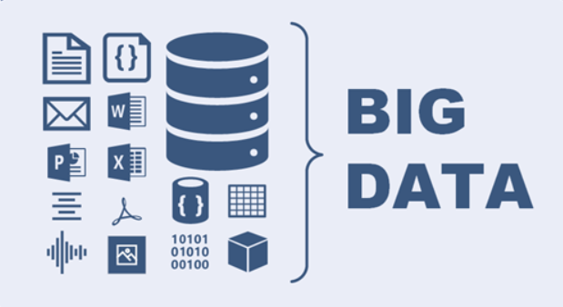
Thank You!

